Slide 2
1. Problem Instances:
A problem instance is a specific input that an algorithm or program needs to process to produce a solution.
For example, if the problem is "sorting a list of numbers," a problem instance would be a particular list of numbers, like.
Different instances of the same problem can have different characteristics, like size, number of elements, or the presence of duplicates.

Slide 3
2. Generalization:
Generalization involves creating more abstract or broad types of solutions that can handle multiple related problem instances.
It's about finding commonalities and patterns across different instances and creating a solution that works for all of them.

Slide 4
3. Classification
Classification is the process of grouping problem instances into categories based on shared characteristics.
This helps in understanding the structure of the problem and choosing the appropriate solution approach.
For example, sorting algorithms can be classified based on their time complexity (e.g., O(n log n) vs. O(n^2)) or the data structures they use (e.g., comparison-based sorting vs. non-comparison-based sorting).

Slide 5
4. Analysis:
Analysis involves examining the efficiency and complexity of different solution approaches.
It helps in choosing the most suitable algorithm or data structure for a given problem instance or class of instances.
In C, you can analyze algorithms using techniques like time complexity analysis (Big O notation), space complexity analysis, and worst-case, average-case, and best-case scenarios.

Slide 6
Problem solving
Problem solving can be defined as “The task of expressing the solution of complex problems in terms of simple operations understood by the computer”.

Slide 7
to solve a problem using a computer we will have to pass through certain stages. The stages are:
Problem definition.
Problem analysis.
Design of a solution using design tools such as Flowcharts and Algorithms.
Programming the computer (Coding).
Checking and correcting errors (Testing and Debugging)
Notes:
In problem analysis we try to understand the requirements of the problem to be solved.

Slide 8
PROBLEM DEFINITION

Slide 9
PROBLEM ANALYSIS
In problem analysis we try to understand the requirements of the problem to be solved. This process is the first step towards the solution domain. Explicit requirements about the input – output, time constraints, processing requirements, accuracy, memory limitations, error handling and interfaces are understood at this stage. The end result of this analysis is the selection of a method, which is to be used on the computer or a decision that a computer should not be used because of constraints as it may be seen that manual methods are better.
To completely and properly specify the input to a program we may have to answer certain questions such as:
What are the values, which should be provided to the program?
What is the order in which the input is to be provided?
What is the format of certain types of data (such as date)?
What is the accuracy of the input data?
What is the input device?
What is the range of values allowed for a particular input?

Slide 10
DESIGN OF PROBLEM SOLUTIONS AND USE OF DESIGN TOOLS
Once the process of problem definition and problem analysis is complete it is necessary for us to define the solution to the problem. The solution should include a sequence of well- defined steps that will input and manipulate the data and produce the desired output. The process of good designing can be done efficiently with the choice of certain design tools. Algorithms and flowcharts are two design tools, which help in the representation of a solution to a problem.
Complex problems can be effectively solved using the computer when they are broken down into sub-problems. Sub-problems are easier to solve than the complete problem. This approach sometimes called as divide and conquer, can be applied to the construction of the problem solution and to the writing of the computer program.

Slide 11
Consider the problem of finding the area of a triangle. This problem can be divided into three sub-problems
Input the data
Compute the area and
Output the results.
Area of a triangle
Input the data
Compute thearea
Output theresults

Slide 12
Advantages
The problem is easily understood and can be logically organized into parts called
modules. Thus, there is a structure to the solution of the problem.
Modifications or changes can be easily made to the modules.
Testing the solution can be easily performed.
Notes:
We now have sufficient detail to implement a computer solution. This approach of dividing a problem into sub-problems, and then dividing the sub-problems further until they can be implemented for computer solution, is called top-down design. The process of refining the solution of a problem at each stage is called as stepwise refinement. Although the triangle area problem is a simple case, the power and effectiveness of top-down design will become evident when we attack more complicated problems. At this point, it is highly recommended that the student apply top-down design to all problems for computer solution

Slide 13
Procedure
A computer cannot solve a problem on its own. One has to provide step by step solutions of the problem to the computer. In fact, the task of problem solving is not that of the computer. It is the programmer who has to write down the solution to the problem in terms of simple operations which the computer can understand and execute.

Slide 14
Algorithm
Writing a logical step-by-step method to solve the problem is called the algorithm. In other words, an algorithm is a procedure for solving problems. In order to solve a mathematical or computer problem, this is the first step in the process.

Slide 15
In order to solve a problem by the computer, one has to pass though certain stages or steps.
1. Understanding the problem
2. Analyzing the problem
3. Developing the solution
4. Coding and implementation.

Slide 16
1. Understanding the problem: Here we try to understand the problem to be solved in totally. Before with the next stage or step, we should be absolutely sure about the objectives of the given problem.
2. Analyzing the problem: After understanding thoroughly the problem to be solved, we look different ways of solving the problem and evaluate each of these methods. The idea here is to search an appropriate solution to the problem under consideration. The end result of this stage is a broad overview of the sequence of operations that are to be carries out to solve the given problem.
3. Developing the solution: Here the overview of the sequence of operations that was the result of analysis stage is expanded to form a detailed step by step solution to the problem under consideration.
4. Coding and implementation: The last stage of the problem solving is the conversion of the detailed sequence of operations in to a language that the computer can understand. Here each step is converted to its equivalent instruction or instructions in the computer language that has been chosen for the implantation

Slide 17
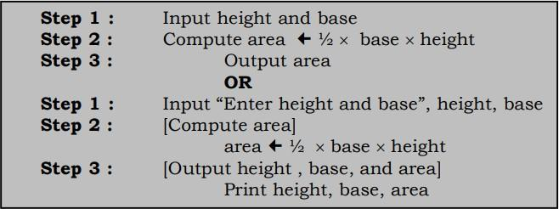
Notes:
This algorithm is specific enoughto be translated into acomputer language, such as C. Note that there is an order to the steps created i.e., Step 1 is performed first, followed by Step
2, and finally Step 3. Once the computer program is written, the computer can execute these instructions in order.

Slide 18

Design an algorithm to find the average of four numbers.
Step 1 :
Step 2 :
Step 3 :
Step 4 :
Step 5 :

Slide 19
Flowchart
A flowchart is the graphical or pictorial representation of an algorithm with the help of different symbols, shapes, and arrows to demonstrate a process or a program.
The main purpose of using a flowchart is to analyze different methods. Several standard symbols are applied in a flowchart:

Slide 20
Flowcharts are classified into two categories :
Program Flowcharts and
System Flowcharts.
Program Flowchart presents a diagrammatic representation of a sequence of instructions for solving a problem.
System Flowchart indicates the flow of data throughout a data processing system, as well as the flow into and out of the system. Such flowcharts are widely used by designers, to explain a data processing system.

Slide 21
Steps Involved in developing Flowcharts
Clearly understand the problem statement so that a proper flowchart can be evolved.
Study the outputs to be generated so that the input can be specified.
Design the process, which will produce the desired result after taking the input.
Refine the process.
Test the flowchart by giving the test data and see if the desired output is generated. If not, make appropriate changes in the process and repeat the process.

Slide 22
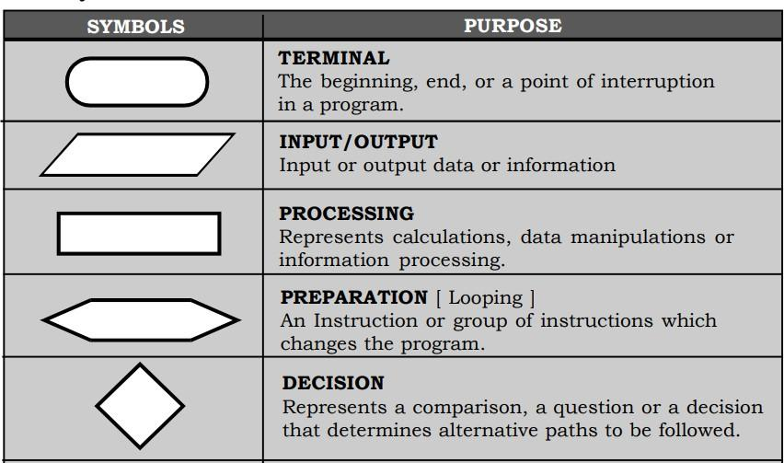
Symbols used in flowcharts

Slide 23
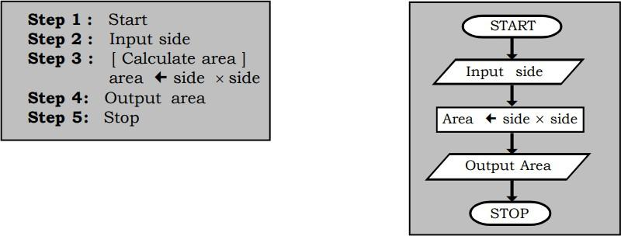
Design a flowchart and an algorithm to find the area of a square

Slide 24
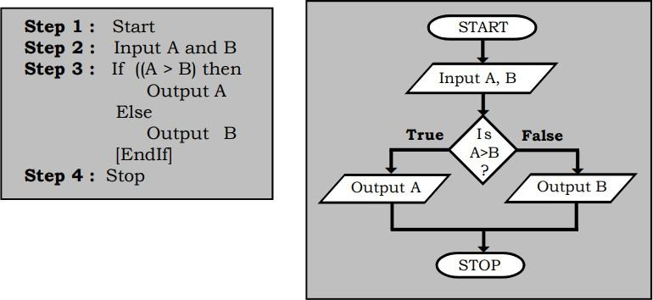
Design aflowchartand an algorithm tofind thelargest of two numbers.

Slide 25
CODING
Definition

Slide 26
DEBUGGING
The process of detecting and correcting errors in a program is referred to as debugging

